Slide 1

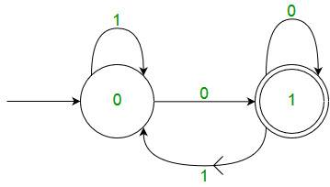


Finite Automata

Slide 2

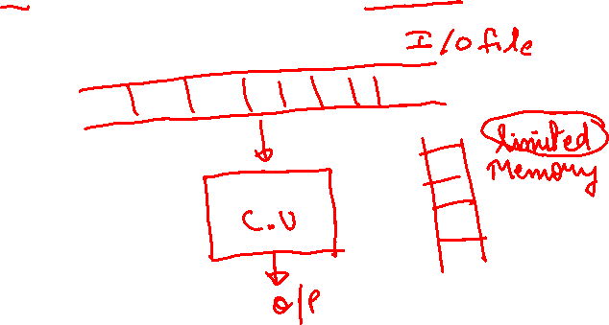
Finite Automata
Finite automata is a severely restricted model of an actual computer.
3

Slide 3
Classification of FA
FA
Y/N
DFA
NFA
String(FSM)
Melay
Moore
3

Slide 4
Representation
Graphical
Tabular
Mathematical
3

Slide 5
Finite Automata
Finite Automata is an abstract computing device. It is a mathematical model of a system with discrete inputs, outputs , sets, and set of state transition from state to state that occur on input symbols from alphabet Σ.
3

Slide 6
Transition diagram
It is a directed graph associated with vertices of graph, corresponds to the state of finite automata.
3

Slide 7
Transition Table
Tabular representation of transition function, that takes two arguments(a state & a symbol) and returns a value (“next state)
Rows correspond to states
Columns corresponding to inputs
Entries correspond to next state
The start state is marked with an arrow
The final state is marked with a star
3

Slide 8
Drawing transition table from transition diagram
3

Slide 9
Transition function
The transition state returns at a state which can be called as a next state.
δ(current state, current input symbol) = next state
3

